Slide 1
Inline Function
#include<iostream>
using namespace std;
class Cube
{
public:
int side;
int getVolume()
{
return side*side*side; //returns volume of cube
}
};
int main()
{
Cube C1;
C1.side = 4; // setting side value
cout<< "Volume of cube C1 = "<< C1.getVolume();
}

Slide 2
#include<iostream>
using namespace std;
class Cube
{
public:
int side;
int getVolume();
};
// member function defined outside class definition
int Cube :: getVolume()
{
return side*side*side;
}
int main()
{
Cube C1;
C1.side = 4; // setting side value
cout<< "Volume of cube C1 = "<< C1.getVolume();
}

Slide 3
#include<iostream>
using namespace std;
class Cube
{
public:
int side;
int getVolume();
};
// member function defined outside class definition
inline int Cube :: getVolume()
{
return side*side*side;
}
int main()
{
Cube C1;
C1.side = 4; // setting side value
cout<< "Volume of cube C1 = "<< C1.getVolume();
}

Slide 4
Constant Variables
The keyword const be used to declare constant variables
They must be initialized when they are declared and cannot be modified later
Using constant variables to specify array size makes program more scalable
Constant variables are also called named constants or read-only variables

Slide 5
Constant Variables
int main()
{
const int a = 5;
const int b; // will cause error
b = 10; // will cause error
const int arr[] = {1, 2, 3, 4, 5};
arr[0] = 10; // will cause error
}

Slide 6
Constant Parameters
int func(const int a, int b)
{
a += 10; //will cause error
b += 20;
}

Slide 7
Constant With Pointers
There are four ways to use const with pointers:
Non-constant pointers to non-constant data
Non-constant pointers to constant data
Constant pointers to non-constant data
Constant pointers to constant data

Slide 8
Non-constant Pointers to Non-constant Data
The highest access is granted by a non-constant pointer to non-constant data
Data can be modified through pointer, and pointer can be made to point to other data

Slide 9
Non-constant Pointers With Non-constant Data
#include<iostream> using namespace std; int main() { int a = 10; int b = 50; int* pA = &a; // *pA contians value 10 *pA = 20; // *pA contains 20 pA = &b; // pA contains 50 cout<<*pA<<endl; //cout<<pA<<endl; }
int main()
{
int a = 10;
int b = 50;
int* pA = &a;
*pA = 20;
pA = &b;
}

Slide 10
Non-constant Pointers to Constant Data
Pointer can be modified to point to any other data, but the data to which it points cannot be modified through that pointer
const int * pVal;

Slide 11
Non-constant Pointers to Constant Data
#include<iostream> using namespace std; int main() { int a = 10; int b = 50; const int* pA = &a; // *pA = 20; /* assignment for read only location *pA*/ pA = &b; // cout<<*pA<<endl; //cout<<pA<<endl; }
int main()
{
int a = 10;
int b = 50;
const int* pA = &a;
*pA = 20; // this line will cause error
pA = &b;
}

Slide 12
Constant Pointers to Non-constant Data
Always points to the same memory location, but the data at that location can be modified through the pointer
int * const pVal = &val;

Slide 13
Constant Pointers to Non-constant Data
#include<iostream> using namespace std; int main() { int a = 10; int b = 50; int* const pA = &a; *pA = 20; pA = &b; // we are trying to modify the adress here so the error will be occured cout<<*pA<<endl; //cout<<pA<<endl; }
int main()
{
int a = 10;
int b = 50;
int* const pA = &a;
*pA = 20;
pA = &b; // this line will cause error
}

Slide 14
Constant Pointers to Constant Data
Always points to the same memory location, and the data at that location cannot be modified via the pointer
const int * const pVal = &val;

Slide 15
Constant Pointers to Constant Data
int main()
{
int a = 10;
int b = 50;
const int* const pA = &a;
*pA = 20; // cannot do this
pA = &b; // cannot do this as well
}

Slide 16
Constructor Overloading
#include <iostream> using namespace std; class construct { public: float RectangleArea; // Constructor with no parameters construct() { RectangleArea = 0; } // Constructor with two parameters construct(int len, int wdt) { RectangleArea = len * wdt; } void disp() { cout<< RectangleArea<< endl; } };
int main() { // Constructor Overloading // with two different constructors // of class name construct o; construct o2( 10, 20); o.disp(); o2.disp(); return 1; }

Slide 17
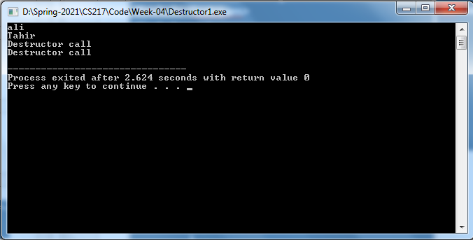
Destructor
#include <iostream> #include <string> using namespace std; class Student { string name; public: Student(string eName) { name = eName; } ~Student(){ cout<<"Destructor call"<<endl; } string getStudentName(){ return name; } };
int main(){ Student s1("ali"); Student s2("Tahir"); cout<<s1.getStudentName()<<endl; cout<<s2.getStudentName()<<endl; }

Slide 18
Copy Constructor
To initialize an object at the time of creation
When an object is passed by value to a function

Slide 19
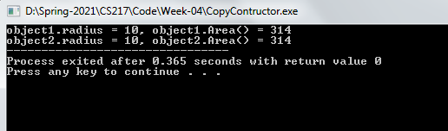
#include<iostream> using namespace std; class Circle { private: int r; public: Circle(int radius) { r = radius; } int Area(){ return 3.14*r*r; } // Copy constructor Circle(const Circle &object1) { r = object1.r; } int getR() { return r; } };
int main() { Circle object1(10); // Normal constructor is called here Circle object2 = object1; // Copy constructor is called here // Let us access values assigned by constructors cout << "object1.radius = " << object1.getR() << ", object1.Area() = " << object1.Area(); cout << "\nobject2.radius = " << object2.getR() << ", object2.Area() = " << object2.Area(); return 0; }

Slide 20
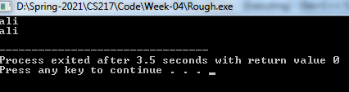
Default Copy Constructor
#include<iostream> using namespace std; class Student{ string name; public: Student(string aname){ name = aname; } string getName(){ return name; } }; int main(){ Student s1("ali"); cout<<s1.getName()<<endl; //dy default copy constructor calls here Student s2 = s1; cout<<s2.getName()<<endl; }

Slide 21

#include<iostream> using namespace std; class Student{ string name; public: Student(const Student &d){// by default copy constructor name = d.name; } Student(string aname){ name = aname; } string getName(){ return name; } }; int main(){ Student s1("ali"); cout<<s1.getName()<<endl; //dy default copy constructor calls here Student s2 = s1; cout<<s2.getName()<<endl; }

Slide 22

#include <iostream> using namespace std; class Employee { public: string *name; //data member(also instance variable) Employee(string name) { this->name = new string(name); } void display() { cout<<*name<<endl; } }; int main() { Employee e1( "Ali"); //creating an object of Employee Employee e2("Khan"); e1.display(); e2.display(); return 0; }
#include <iostream> using namespace std; class Employee { public: string name; //data member(also instance variable) Employee(string name) { this->name = name; } void display() { cout<<name<<endl; } }; int main() { Employee e1( "Ali"); //creating an object of Employee Employee e2("Khan"); e1.display(); e2.display(); return 0; }

Slide 23
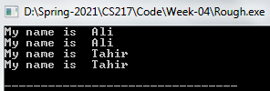
#include<iostream> using namespace std; class Student{ public: string *name; Student(string name){ this->name = new string(name); } void chnageName(string name){ *(this->name) = name; } void introduce(){ cout<<"My name is "<<*name<<endl; } };
int main(){ Student s1("Ali"); Student s2 = s1; s1.introduce(); s2.introduce(); s1.chnageName("Tahir"); s1.introduce(); s2.introduce(); }

Slide 24
//Student #include<iostream> using namespace std; class Student{ public: string *name; Student(string name){ this->name = new string(name); // "this " the pointer which retrieve the name stored in the string } Student(const Student &p){ // copy contructor name = new string(*p.name);// intialized the name } void chnageName(string name){ *(this->name) = name; } void introduce(){ cout<<"My name is "<<*name<<endl; } };
int main(){ Student s1("Ali"); Student s2 = s1; s1.introduce(); s2.introduce(); s1.chnageName("Tahir"); s1.introduce(); s2.introduce(); }

Slide 25
Deep copy
//Student #include<iostream> using namespace std; class Student{ public: string *name; int rollNumber; Student(string name, int aRollNumber){ this->name = new string(name); // "this " the pointer which retrieve the name stored in the string rollNumber = aRollNumber; } Student(const Student &p){ // copy contructor name = new string(*p.name);// intialized the name rollNumber = p.rollNumber; // initialized rollnumber } void chnageName(string name, int aRollNumber){ *(this->name) = name; rollNumber = aRollNumber; } void introduce(){ cout<<"My name is "<<*name<<" and my student id is: "<<rollNumber<<endl; } };
int main(){ Student s1("Ali", 2021); Student s2 = s1; s1.introduce(); s2.introduce(); s1.chnageName("Tahir",2022); s1.introduce(); s2.introduce(); }

Slide 26
Exercise
Create a class called Payroll that includes three pieces of information as data members—a first name, a last name and a monthly salary. Your class should initialize the three data members as soon as an object is created. First name must always be provided beforehand, last name is an optional field, monthly salary should also be provided. However, if the salary isn’t provided, we know that it can never be less than Rs20,000. Also make getter function for each data member. If the monthly salary input is not positive, set it to 0.
Write a test program that demonstrates class Payroll’s capabilities. Create two objects and display each object’s yearly salary.

